Slide 1

Sales Dataset Analysis
Raagulpradan d

Slide 2
Project Objective:
To analyze retail sales transaction data, extract key insights, and create interactive visualizations using Microsoft Excel.
While leveraging advanced tools like What-If Analysis, Goal Seek, Macros, Power Query.
Generate actionable insights that support decision-making and future strategy development.
Goals:
Analyze sales trends over time to understand seasonal patterns and growth.
Identify high-performing products and sales channels contributing to overall revenue.
Develop a dynamic Excel dashboard to display key performance metrics interactively

Slide 3
Dataset Overview
Superstores Sales dataset exists with 9994 rows, columns such as Row ID, Column ID, Order Date, Ship Date, Customer ID, Customer Name, Segment, Country, City, State, Postal code, Region, Product ID, Category, Sub category, Product Name, Sales, Quantity, Discount, Profit, Adjusted Sales.
Data Cleaning Process:
I used Power Query to clean the Raw Dataset.
Format the columns for better readability.
Use Date formatting for the "Order Date" and "Ship Date" columns to ensure proper sorting and filtering.
Remove duplicate rows and error in the dataset.
Use data validation to ensure that all data entries (like sales numbers and dates) are consistent and free of errors.

Slide 4
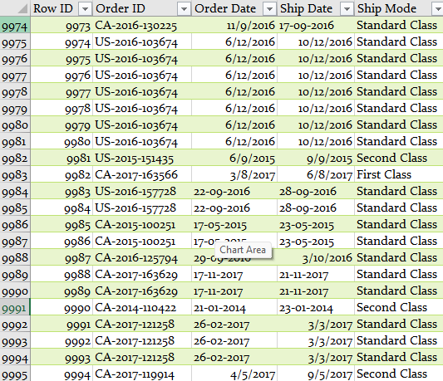
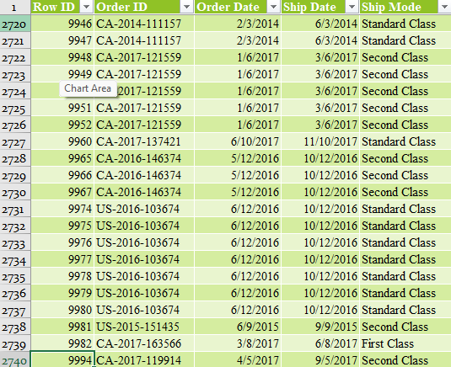
Dataset Before and After Cleaning

Slide 5
Key Metrics Calculation and Data Analysis
Perform calculations of key metrics such as total sales, average order value, profit margins, and total discounts, followed by in-depth analysis to identify sales trends, product performance, and customer behavior insights.
Total Revenue
3074838.579
Total Discount
1689.87
Average Ordered value
3.767798467
Total Adjusted Sales
3050475.025

Slide 6
Pivot Tables and Pivot Charts
PivotTables were used to summarize and analyze large sales datasets by key dimensions such as product type, sales channel, and time period, enabling quick calculation of totals, averages, and comparisons.
Pivot Charts, built on these PivotTables, provided dynamic visualizations that updated automatically with filters and slicers, making it easier to identify trends, patterns, and performance insights at a glance.
Row Labels | Sum of Adjusted Sales
First Class | 533591.8572
Same Day | 260856.4919
Second Class | 649188.3049
Standard Class | 1606838.371
Grand Total | 3050475.025
Row Labels | Sum of Adjusted Sales
Furniture | 1030720.621
Office Supplies | 814113.9265
Technology | 1205640.477
Grand Total | 3050475.025
Row Labels | Sum of Adjusted Sales
Consumer | 1347475.135
Corporate | 986986.4201
Home Office | 716013.4706
Grand Total | 3050475.025

Slide 7
Ship Mode
Segment
Category

Slide 8
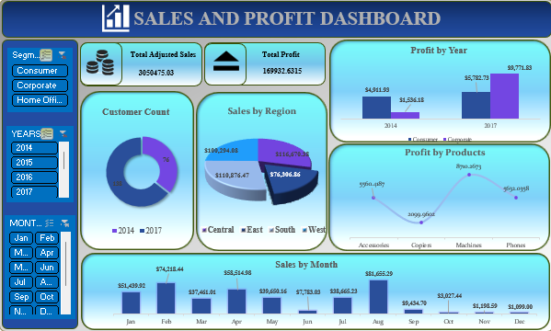
Dashboard Overview

Slide 9
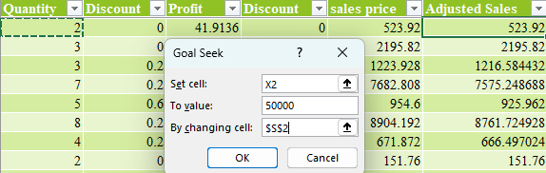
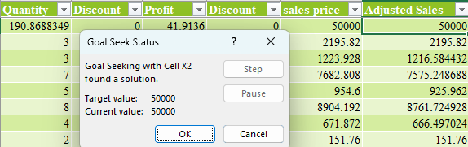
What-If Analysis & Goal Seek
Use Goal Seek to determine the sales target needed to achieve a specific revenue or profit goal. For example, set a goal for Adjusted Sales or Profit and use Goal Seek to find out how many units of a product need to be sold to reach that target.
Goal Seek
Quantity | 190.8688
Adjusted Sales | 50000

Slide 10
Insights and Recommendations
Sales Channel Performance
Standard Class channel contributes the highest sales volume and revenue.
Category Insights
Technology is the Best-performing category show strong Adjusted Sales and high quantity sold.
Discount Impact Analysis
Discounts reduce Net Sales significantly; difference of 24,363 observed between Net Sales and Adjusted Sales.
Excessive discounts may hurt profitability despite higher sales volume.
Recommendations
Focus on high-performing sales channels (e.g., Standard Class) to boost overall revenue.
Optimize discount strategies by targeting specific products instead of broad reductions.
Promote underperforming category products via marketing or bundling offers.
Analyze returns data (if available) to identify product quality or customer experience issues.

Slide 11
Conclusion
Standard Class drives the highest sales; Category shows mixed performance.
Discounts impact net sales (difference: 24,363) — need targeted discount strategies.
Focus on high-performing channels and improve underperforming products to boost revenue.
Next Steps
Analyze customer segments for personalized strategies.
Review returns to reduce losses and improve quality.

